Slide 1

Season of AI – Season 2
Gosia Borzecka – Microsoft MVP AI
Marcel Lupo – Microsoft MVP Developer Technologies + Azure

Slide 2

Visual Studio Code + Copilot + Extensions for Azure?
Notes:
People may think that Visual Studio and Copilot are not compatible, because Visual Studio has intellisense and robust features.
But we are here to show that the AI revolution will impact the way that developers code and build new products for everyone.

Slide 3
“How do I use GitHub Copilot as my peer programmer to not only help me code my Infrastructure…” “… but also visualise it?”
Notes:
One refrain that we’ve heard loud and clear from people is, how do I get the most out of this thing? I mean, these demos of Copilot writing a regex are cool and all, but how do I really level up my programming game with GitHub Copilot and become an AI programming expert?
But first we need to understand what GitHub Coplot actually is.

Slide 4

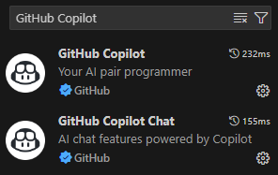


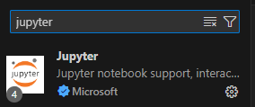
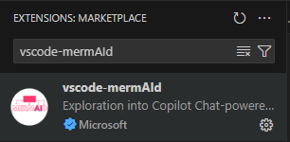
Your AI Pair Programmer Toolbox
Visual Studio Code
AZ CLI
Python
VS Code Extensions:
Azure CLI Tools
GitHub Copilot
GitHub Copilot for Azure
Jupyter
Vscode-mermAId
Notes:
GitHub Copilot is advertised as Your AI Pair Programmer. But what exactly does that mean?
The first thing that you need to know is that GitHub Copilot is not an AI. It is the name of a suite of AI Tools that you’ll find in a lot of places – including GitHub.com and Visual Studio.

Slide 5


“Create a deployment”
System: You are a friendly coding assistant…
User: Create a secure webserver with SQL integration
```powershell
$resourceGroupName = "github-copilot-web-apps"
$location = "uksouth"…```
Assistant: Sure! Here you go..
Notes:
Lets’s say you make a request such as “create a webserver in typescript”, GitHub Copilot does a few things..
It enables you to make that request with some sort of user interface element – we’ll look at these different interaction models in a moment.
It takes your request and it adds to it something called a “system prompt”, as well as any context – other information or code that it thinks will be helpful in answering your question – and creates a prompt.
It identifies which GPT model to use – GPT 3.5 is fast, but 4.0 is accurate – so it tries to pick the right one based on the requested interaction.
It sends the request to the OpenAI model
It then parses the response from the model so that it can provide that code to you in the requested interaction format – either in chat in the editor or by adding code directly to your file.

Slide 6
Demo time!
Notes:
Let’s craft with Visual Studio, .NET 8, Blazor and Github Copilot.

Slide 7

System: You are a friendly coding assistant connected to Azure…
User: Is my stuff secure?
“@Azure is everything there?”
Query
Result
You web application looks to have an identity, but the identity has no permissions set in Entra… Oh wait, it has a SQL server admin access
Assistant: Everything looks good..
Notes:
Lets’s say you make a request such as “create a webserver in typescript”, GitHub Copilot does a few things..
It enables you to make that request with some sort of user interface element – we’ll look at these different interaction models in a moment.
It takes your request and it adds to it something called a “system prompt”, as well as any context – other information or code that it thinks will be helpful in answering your question – and creates a prompt.
It identifies which GPT model to use – GPT 3.5 is fast, but 4.0 is accurate – so it tries to pick the right one based on the requested interaction.
It sends the request to the OpenAI model
It then parses the response from the model so that it can provide that code to you in the requested interaction format – either in chat in the editor or by adding code directly to your file.

Slide 8
Demo time!
Notes:
Let’s craft with Visual Studio, .NET 8, Blazor and Github Copilot.

Slide 9

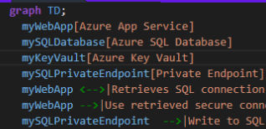
“Everything looks good, but how does this architecture “look” like @mermAId?”
System: You are a friendly coding assistant using mermAId…
User: What would this infrastructure architecture look like on a diagram?
Assistant: This is what the architecture looks like..
Notes:
Lets’s say you make a request such as “create a webserver in typescript”, GitHub Copilot does a few things..
It enables you to make that request with some sort of user interface element – we’ll look at these different interaction models in a moment.
It takes your request and it adds to it something called a “system prompt”, as well as any context – other information or code that it thinks will be helpful in answering your question – and creates a prompt.
It identifies which GPT model to use – GPT 3.5 is fast, but 4.0 is accurate – so it tries to pick the right one based on the requested interaction.
It sends the request to the OpenAI model
It then parses the response from the model so that it can provide that code to you in the requested interaction format – either in chat in the editor or by adding code directly to your file.

Slide 10
Demo time!
Notes:
Let’s craft with Visual Studio, .NET 8, Blazor and Github Copilot.

Slide 11

Notes:
Let’s craft with Visual Studio, .NET 8, Blazor and Github Copilot.

Slide 12





Thank you. For the GitHub Repo containing this demo Scan me >
^
^

